Slide 1
Module 12 - Performance Optimization & App Deployment

Slide 2
Learning Objectives
Content:
Explain how Flutter renders widgets and what causes performance overhead
Identify common performance bottlenecks in Flutter UI
Use DevTools to diagnose rebuilds, repaints, memory, and CPU load
Apply best practices to optimize task lists, images, and widget trees
Analyze and reduce app size before release
Build a release APK / AppBundle suitable for distribution
Notes:
Emphasize: performance & deployment are essential for “real apps”.

Slide 3
Why Performance Matters in Flutter
Performance affects:
Frame Rendering
Flutter aims for 60 FPS → 16.6ms per frame
New devices: 120 FPS → 8ms per frame
User Experience
Stutters, dropped frames, slow scrolling → feels cheap
Poorly optimized lists = biggest cause of student app lag
Device Constraints
Limited CPU/GPU (especially mid-range Android devices)
Flutter rebuilds are cheap but not free
Real-world publishing
Store policies require reasonable size
Large apps increase uninstall probability
Notes:
1. What is FPS?
FPS = Frames Per Second → the number of frames drawn on the screen in 1 second.
60 FPS = 60 frames per second
120 FPS = 120 frames per second
The higher the FPS → the smoother the application.
Flutter must finish drawing each frame within the allowed time (16.6ms or 8ms).
If a build, layout, or paint operation takes longer, the UI stutters because frames are dropped.

Slide 4
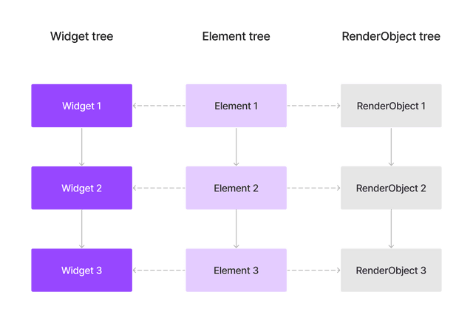
How Flutter Builds the UI (Render Pipeline)
Key Concepts:
Widgets are immutable blueprints
Elements handle lifecycle & state
RenderObjects perform layout, painting, compositing
Performance Principle:
Avoid extra work in build(), reduce unnecessary rebuilds.
Notes:
This slide provides foundational theory before optimization techniques.

Slide 5
What Causes Performance Problems?
Common issues:
Too many widget rebuilds
Re-running heavy logic inside build()
Large images decoded at full resolution
Overly deep widget trees
Incorrect use of setState or Provider listeners
Inefficient list rendering
Expensive synchronous operations in the UI thread
Use of GlobalKey everywhere
Example issues in student apps:
ListView lag with many items
Constant rebuild of whole screens
Loading full-resolution images from network

Slide 6
Flutter DevTools Overview
Key Tools:
Performance: FPS timeline, frame rendering cost
CPU Profiler: execute-time hotspots
Memory: leaks & allocations
Widget Inspector: identify rebuild sources
Repaint Rainbow: highlight repaint operations
Rebuild Tracker (extensions): count widget rebuilds
DevTools Usage Tips:
Run app in Profile Mode for accurate data
Avoid measuring performance in Debug mode.
Notes:
DevTools provides visibility into how your app performs.

Slide 7
Identifying Rebuild Issues
Flutter rebuild issues typically come from:
State misplacement:
If state lives too high → entire UI rebuilds
If state lives too low → data not propagated properly
Missing const constructors:
const lets Flutter skip rebuilding widgets
Overuse of setState:
Calling setState() on large widgets triggers mass rebuilds
Provider misconfiguration:
Using context.watch<T>() instead of Selector<T>() leads to redundant rebuilds

Slide 8
Optimization Technique 1: Use const Effectively
Why const matters:
Reduces rebuilds
Saves memory
Helps Flutter tree diffing
Note:
If the widget never changes → use const.
Example:
Before:
Text("Task Title")
After:
const Text("Task Title")

Slide 9
Optimization Technique 2: Extract Widgets
Large widgets rebuilding unnecessarily = lag.
Benefits:
Only TaskTile rebuilds
Parent ListView stays untouched
Cleaner code structure
Note:
Use extraction + const for maximal effect.
Example (Taskly):
Before:
ListTile(
title: Text(task.title),
trailing: Checkbox(...),
)
After:
TaskTile(task: task) // separate widget

Slide 10
Optimization Technique 3: Avoid Heavy Work in build()
Absolutely do not do it inside the build() function.
Sorting
Parsing JSON
Complex calculations
Database reads
API calls
Example Anti-pattern:
Widget build(context) {
final sorted = tasks..sort(); // NO
}
Correct:
sortTasks(); // call once

Slide 11
Optimization Technique 4: Using Keys Properly
When to use keys:
Preserving state
Animations
Reordering lists
Improving diffing performance
GlobalKey Warning:
Powerful but slow
Avoid unless needed for navigation or accessing widget state
Good:
ValueKey(task.id)
Bad:
UniqueKey() // forces rebuild every frame

Slide 12
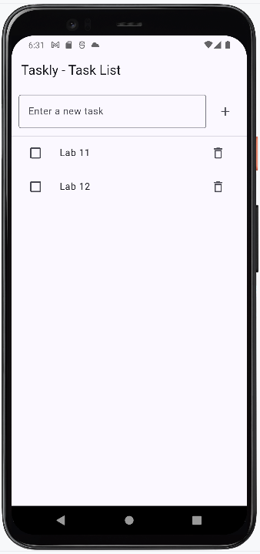
Taskly Optimization Overview
We will apply the module’s performance techniques to optimize and deploy the Taskly app
Why Taskly?
Small enough to understand quickly
Complex enough to reveal real performance issues
Perfect for demonstrating measurable improvements
Focus Areas
UI Optimization
List Performance
Resource Efficiency
App Size Analysis
Deployment Prep

Slide 13
Demo 12.1 - Optimize List & UI Rebuilds (Taskly) Improve performance by reducing unnecessary widget rebuilds
Objectives
Understand why the old Taskly implementation caused full-screen rebuilds
Apply widget extraction (TaskTile)
Use Selector to minimize rebuild scope
Add const where possible for stable widgets
Observe rebuild reduction using debug logs or DevTools
The Problem (Before Optimization)
Issue: The entire TaskListScreen rebuilds whenever tasks change.
Why it’s slow
context.watch<TaskProvider>() used at the top of the widget
List items rendered inline in itemBuilder
No separation between static UI (input row) and dynamic UI (list)
ListView rebuilds all items even when only one task changes

Slide 14
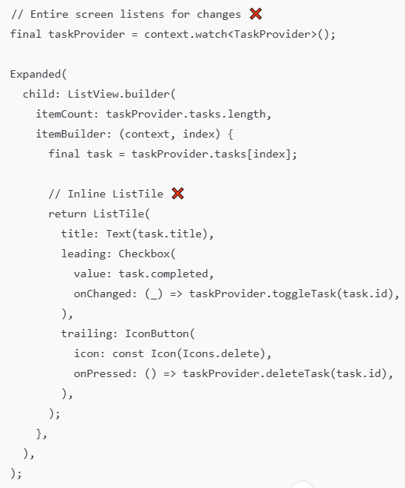
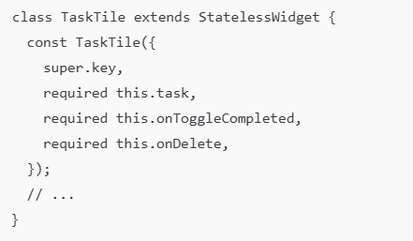
Demo 12.1 - (continued)
Before Code (Inefficient)
Solution (After Optimization)
We isolate list rebuilds and extract item UI.
1) Extract TaskTile widget
Full-screen rebuild → laggy scrolling, poor performance on long lists.

Slide 15
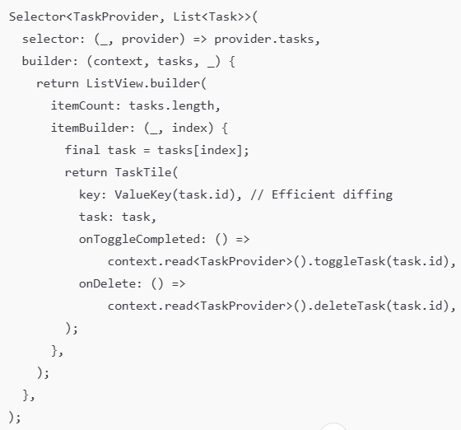
Demo 12.1 - (continued)
Solution (After Optimization)
2) Use Selector to rebuild ONLY the list
3) Make input UI independent of task list
Performance Result
Before:
Entire screen rebuilds
All list items rebuilt on every action
After:
Only the list rebuilds
Only the affected TaskTile rebuilds
Smoother scrolling
Cleaner, maintainable architecture
Notes:
Encourage students to inspect rebuild counts using debugPrint or DevTools Rebuild Profiling
Emphasize separation of concerns (static UI vs dynamic UI)
This optimization pattern applies to all real Flutter apps using lists
Use Demo 12.1 as the “model pattern” for later performance labs

Slide 16
Demo 12.2 - Image Optimization Improve image loading performance and reduce layout cost.
Objectives
Understand why large or uncompressed images affect performance
Apply resizing, caching, and placeholders
Avoid heavy work in build()
Key Optimization Techniques
Resize images before use
Avoid loading 2000px images for 50px thumbnails.
2. Pre-cache frequently used images
precacheImage(const AssetImage('assets/category.png'), context);
3. Use FadeInImage for remote images
4. Avoid decoding images in build()
➡ Decode once in initState if needed.
FadeInImage.assetNetwork(
placeholder: 'assets/loading.png',
image: task.imageUrl,
)
Image.asset(
'assets/category.png',
width: 48,
height: 48,
)
Notes:
Although Taskly doesn't use images, this knowledge applies to all real-world Flutter apps (e-commerce, social apps, galleries, etc.).

Slide 17

Demo 12.3 - App Size Analysis
Objectives
Generate size analysis report using Flutter CLI
Understand breakdown of: code size, assets, packages
Identify unnecessary dependencies or large assets
1. Build debug vs release
flutter build apk --debug
flutter build apk --release
2. Analyze app size
flutter build apk --analyze-size
Output: JSON + HTML tree map fileDart AOT code size
Native libraries
Assets folder breakdown
Package contributions
3. Common Size Optimization Tips
Remove unused assets
Compress large images
Delete unused dependencies from pubspec.yaml
Enable tree-shaking icons (Material icons off)
Notes:
This demo helps students understand the app size when deploying it in practice.
Most student projects include unused assets → useful in real practice.

Slide 18
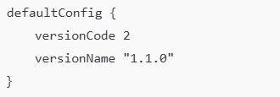
Demo 12.4: Building & Deploying The Release App (Taskly)
Objectives
Understanding Release vs Debug vs Profile modes
Build Release APK / AppBundle
Configure app version
(Optional) Sign the application for Google Play
Validate final build size and performance
1. Preparing Project for Release
Check versioning
File: android/app/build.gradle
Version rules:
versionCode = integer (must increase every release)
versionName = display version
2. Run App in Profile Mode
Command
flutter run --profile
Purpose
Runs the app with near-release performance
Removes debugging overhead
Helps you check smoothness, scrolling, and build/render cost
Notes
Profile mode is recommended before building the final Release APK
No code changes required, just run and observe the behavior

Slide 19
Demo 12.4 (continued)
3. Build Release APK
Command
flutter build apk --release
Output location:
build/app/outputs/flutter-apk/app-release.apk
What students should verify:
App starts instantly
Performance smoother than Debug mode
No debug banners, no hot reload
4. Build AppBundle (AAB) for Google Play
Google Play requires .aab instead of .apk.
flutter build appbundle --release
Output:
build/app/outputs/bundle/release/app-release.aab

Slide 20
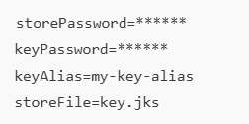
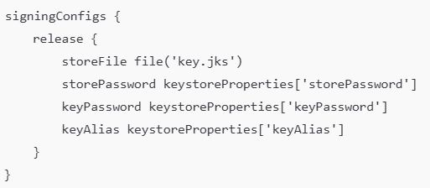
Demo 12.4 (continued)
5. Optional - App Signing Configuration
If publishing to Google Play, generate a keystore:
Add file: android/key.properties
Update build.gradle:

Slide 21
Demo 12.4 (Completed)
After completing Demo 12.4, you will have:
A fully optimized Release build of Taskly (APK/AAB)
A verified performance-checked version using Profile mode
A project configured and ready for real deployment
→ Your app is now production-ready.
Notes:
Deployment Checklist
Remove debug statements
Check app icons & splash screen
Clean unused assets
Ensure versionCode updated
Run performance test in Profile mode
Test release APK on a physical device
Review size report (--analyze-size)
Scan for crashes or errors

Slide 22
Best Practices
1. Rendering
Use const
Extract widgets
Avoid heavy work in build()
2. State & Rebuilds
Use Selector / fine-grained updates
Keep state close to where it’s used
3. Lists
Use ListView.builder
Extract list items
Use stable keys (ValueKey)
4. Images
Resize & compress
Pre-cache
Avoid decoding in build()
5. App Size
Remove unused assets/deps
Enable icon tree-shaking
6. DevTools & Deployment
Test in Profile mode
Fix jank/rebuild hotspots
Build Release APK/AAB and update versioning

Slide 23
Summary
In Module 12, students learned to:
Understand Flutter’s rendering pipeline and common performance bottlenecks
Identify issues such as unnecessary rebuilds, heavy image decoding, inefficient lists
Use DevTools for profiling FPS, memory, rebuilds, and CPU
Apply practical optimizations: const, widget extraction, Selector, list tuning
Analyze and reduce app size using Flutter’s size tools
Build Release APK/AAB, verify performance in Profile mode, and prepare the app for deployment
Optimize the Taskly app and produce a production-ready release build

Slide 24
References
Kevin Moore, Mastering Flutter 2025: Learn to Develop Flutter Apps, Packt Publishing. → Relevant chapters: Ch. 13 – Performance, Ch. 14 – DevTools, Ch. 15 – Deployment
Flutter Docs
Rendering & Performance: https://docs.flutter.dev/perf/
DevTools: https://docs.flutter.dev/tools/devtools/overview
App Size: https://docs.flutter.dev/perf/app-size
Deployment (Android): https://docs.flutter.dev/deployment/android
Packages
Provider: https://pub.dev/packages/provider
Flutter Test API: https://api.flutter.dev/flutter/flutter_test/flutter_test-library.html

